Slide 1
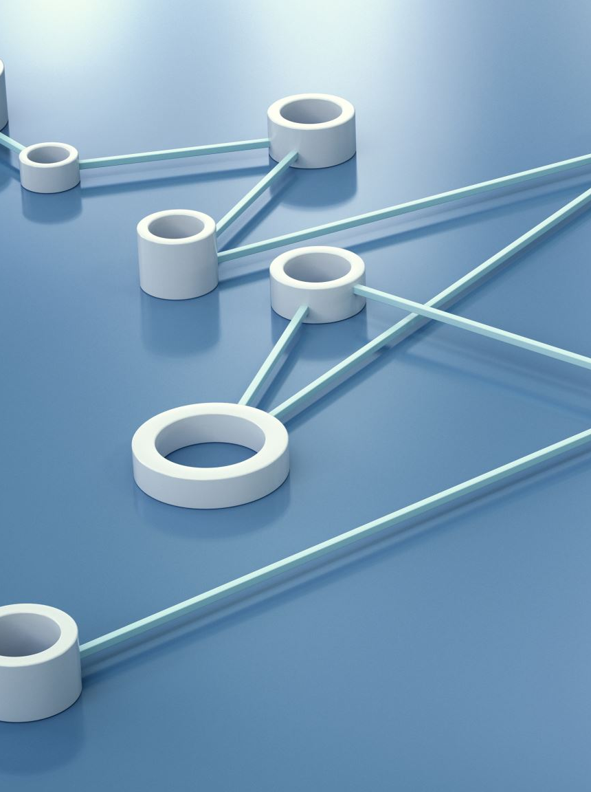
Inter Process Communication

Slide 2
Interprocess Communications
Exchange of data between two or more separate, independent processes/threads.
Operating systems provide facilities/resources for inter-process communications (IPC), such as message queues, semaphores, and shared memory.
Distributed computing systems make use of these facilities/resources to provide application programming interface (API) which allows IPC to be programmed at a higher level of abstraction. (e.g., send and receive)
Distributed computing requires information to be exchanged among independent processes.
Notes:
Interprocess Communications in Unix, the Nook and Crannies by John Shapley Gray. Prentice Hall.

Slide 3
IPC – Unicast and Multicast
In distributed computing, two or more processes engage in IPC using a protocol agreed upon by the processes. A process may be a sender at some points during a protocol, a receiver at other points.
When communication is from one process to a single other process, the IPC is said to be a unicast, e.g., Socket communication. When communication is from one process to a group of processes, the IPC is said to be a multicast, e.g., Publish/Subscribe Message model

Slide 4
Unicast vs. Multicast

Slide 5
Interprocess Communications in Distributed System

Slide 6

Operations provided in an archetypal Interprocess Communication API
Receive ( [sender], message storage object)
Connect (sender address, receiver address), for connection-oriented communication.
Send ( [receiver], message)
Disconnect (connection identifier), for connection-oriented communication.

Slide 7
Interprocess Communication in basic HTTP
s4
Processing order: C1, S1, C2, S2, S3, C3, C4, S4

Slide 8

Event Synchronization
Interprocess communication may require that the two processes synchronize their operations: one side sends, then the other receives until all data has been sent and received.
Ideally, the send operation starts before the receive operation commences.
In practice, the synchronization requires system support.

Slide 9
Synchronous vs Asynchronous
Synchronous: do it now, wait until over
Asynchronous: start it now, check later
Somewhat related:
Blocking: wait until it’s all done
Non-blocking: only do what can be done without blocking

Slide 10
Transferring Large Files
OS buffers are 16-64KB
Large files are >> buffer size
Assume two clients
Each requests a different large file
Both are on slow networks
How do you design your server?

Slide 11
Server Design Choices
Processes
Each client handled by a different process
Threads
Each client handled by a different thread
Single process
Use nonblocking operations, multiplex

Slide 12
Processing Steps
Accept
Conn
Read
Request
Find
File
Send
Header
Read File
Send Data
end

Slide 13
Blocking Steps
Disk Blocking
Accept
Conn
Read
Request
Find
File
Send
Header
Read File
Send Data
end
Network Blocking

Slide 14
Concurrency Architecture
Overlap disk, network, & application-level processing
Architecture how steps are overlapped
Note: implications for performance

Slide 15
Multiple Processes (MP)
Process 1
Accept
Conn
Read
Request
Find
File
Send
Header
Read File
Send Data
Process N
Accept
Conn
Read
Request
Find
File
Send
Header
Read File
Send Data
Pro: simple programming – rely on OS
Cons: too many processes
caching harder

Slide 16
Multiple Threads (MT)
Accept
Conn
Read
Request
Find
File
Send
Header
Read File
Send Data
Pro: shared address space
lower “context switch” overhead
Cons: many threads
requires kernel thread support
synchronization needed

Slide 17
Single Process Event Driven (SPED)
Accept
Conn
Read
Request
Find
File
Send
Header
Read File
Send Data
Event Dispatcher
Pro: single address space
no synchronization
Cons: must explicitly handle pieces
in practice, disk reads still block

Slide 18
Middleware Layers

Slide 19
Characteristics of IPC
Synchronous & Asynchronous Communication
Synchronous: Blocking
Asynchronous: Non-Blocking
Sending is non-blocking
Receiving can be blocking or non-blocking
Message Destination:
IP Address
Port No.
Reliability
Ordering: Sequencing of packets

Slide 20
Sockets
agreed port
any port
socket
socket
message
client
server
other ports
Internet address = 138.37.94.248
Internet address = 138.37.88.249

Slide 21
JAVA API for IP Address
Package: import java.net.*;
InetAddress: Represents ip address
Give DNS hostname as an input.
E.g.
InetAddress aComp=InetAddress.getByName( “dsc.gmul.co.uk”);

Slide 22
Types of Sockets
UDP Datagram
TCP Stream
Difference between TCP and UDP

Slide 23
UDP Datagram Communication
Issues related to Datagram:
Message Size
Blocking
Non-blocking: send
Blocking: Receive
Timeouts
Receive from Any

Slide 24
Failure Model for UDP
Omission Failure
Checksum error
No buffer space at sender or receiver
Send-omission or receive omission can be possible
Ordering: No sequence
Examples of UDP:
DNS: Domain Name Service
VOIP: Voice over IP

Slide 25
JAVA API for UDP
DatagramPacket: A class which provides a constructor that will handle following fields
Message Retrieval: getData
IP Address: getAddress
Port: getPort
Array of bytes containing message
Length of Message
IP Address
Port No.

Slide 26
DatagramSocket: for sending and receiving UDP Datagrams
Methods
Send
Receive
setSoTimeOut
Connect

Slide 27
UDP client sends a message to the server and gets a reply
import java.net.*;
import java.io.*;
public class UDPClient{
public static void main(String args[]){
// args give message contents and server hostname
DatagramSocket aSocket = null;
try {
aSocket = new DatagramSocket();
byte [] m = args[0].getBytes();
InetAddress aHost = InetAddress.getByName(args[1]);
int serverPort = 6789;
DatagramPacket request = new DatagramPacket(m, args[0].length(), aHost, serverPort);
aSocket.send(request);
byte[] buffer = new byte[1000];
DatagramPacket reply = new DatagramPacket(buffer, buffer.length);
aSocket.receive(reply);
System.out.println("Reply: " + new String(reply.getData()));
}catch (SocketException e){System.out.println("Socket: " + e.getMessage());
}catch (IOException e){System.out.println("IO: " + e.getMessage());}
}finally {if(aSocket != null) aSocket.close();}
}
}

Slide 28
UDP server repeatedly receives a request and sends it back to the client
import java.net.*;
import java.io.*;
public class UDPServer{
public static void main(String args[]){
DatagramSocket aSocket = null;
try{
aSocket = new DatagramSocket(6789);
byte[] buffer = new byte[1000];
while(true){
DatagramPacket request = new DatagramPacket(buffer, buffer.length);
aSocket.receive(request);
DatagramPacket reply = new DatagramPacket(request.getData(),
request.getLength(), request.getAddress(), request.getPort());
aSocket.send(reply);
}
}catch (SocketException e){System.out.println("Socket: " + e.getMessage());
}catch (IOException e) {System.out.println("IO: " + e.getMessage());}
}finally {if(aSocket != null) aSocket.close();}
}
}

Slide 29
TCP Stream Communication
Characteristics:
Message size
Lost Messages
Flow control
Messages duplication and ordering
Message destinations
Use of TCP:
HTTP, FTP, SMTP, Telnet

Slide 30
Failure Model of TCP
Reliability:
Integrity: uses checksums to detect and reject corrupt packets and sequence numbers to detect and reject duplicate packets.
Validity: uses timeouts and retransmissions to deal with lost packets.
Effects of Connection broken:
The processes cannot distinguish between network failure of the process at the other end of the connection
The communication processes cannot tell whether recent message received or not.

Slide 31
JAVA API for TCP Streams
ServerSocket: Using by server to create socket at a server port for listening requests.
Accept(): gets connect request from queue. If queue is empty, it blocks till one arrives.
The result of executing accept() is an instance of Socket which is for giving access to streams for communication with the client.

Slide 32
Socket: The client uses a constructor to create a socket, specifying DNS hostname and port number. And also connects it to the specifies remote computer and port number.
Methods:
getInputStream()
getOutputStream()

Slide 33
Server side Socket Operations
1. Open Server Socket:
String server;
Socket slink;
DataOutputStream os;
DataInputStream is;
ServerSocket server = new ServerSocket( PORT );
2. Wait for Client Request:
Socket client = server.accept();
3. Create I/O streams for communicating to clients
is = new DataInputStream( client.getInputStream() );
os = new DataOutputStream( client.getOutputStream() );
4. Perform communication with client
Receive from client: String line = is.readLine();
Send to client: os.writeBytes("Hello\n");
5. Close sockets: client.close();
For multithreade server:
while(true) {
i. wait for client requests (step 2 above)
ii. create a thread with “client” socket as parameter (the thread creates streams (as in step (3) and does communication as stated in (4). Remove thread once service is provided.
}

Slide 34
Client side Socket Operations
1. Get connection to server:
Socket client = new Socket( server, port_id );
2. Create I/O streams for communicating to clients
is = new DataInputStream( client.getInputStream() );
os = new DataOutputStream( client.getOutputStream() );
3. Perform communication with client
Receive from client:
String line = is.readLine();
Send to client: os.writeBytes("Hello\n");
4. Close sockets: client.close();

Slide 35
TCP client makes connection to server, sends request and receives reply
import java.net.*;
import java.io.*;
public class TCPClient {
public static void main (String args[]) {
// arguments supply message and hostname of destination
Socket s = null;
try{
int serverPort = 7896;
s = new Socket(args[1], serverPort);
DataInputStream in = new DataInputStream( s.getInputStream());
DataOutputStream out = new DataOutputStream( s.getOutputStream());
out.writeUTF(args[0]);
String data = in.readUTF();
System.out.println("Received: "+ data) ;
}catch (UnknownHostException e){
System.out.println("Sock:"+e.getMessage());
}catch (EOFException e){System.out.println("EOF:"+e.getMessage());
}catch (IOException e){System.out.println("IO:"+e.getMessage());}
}finally {if(s!=null) try {s.close();}catch (IOException e){System.out.println("close:"+e.getMessage());}}
}
}

Slide 36
TCP server makes a connection for each client and then echoes the client’s request
import java.net.*;
import java.io.*;
public class TCPServer {
public static void main (String args[]) {
try{
int serverPort = 7896;
ServerSocket listenSocket = new ServerSocket(serverPort);
while(true) {
Socket clientSocket = listenSocket.accept();
Connection c = new Connection(clientSocket);
}
} catch(IOException e) {System.out.println("Listen :"+e.getMessage());}
}
}
// this figure continues on the next slide

Slide 37
class Connection extends Thread {
DataInputStream in;
DataOutputStream out;
Socket clientSocket;
public Connection (Socket aClientSocket) {
try {
clientSocket = aClientSocket;
in = new DataInputStream( clientSocket.getInputStream());
out =new DataOutputStream( clientSocket.getOutputStream());
this.start();
} catch(IOException e) {System.out.println("Connection:"+e.getMessage());}
}
public void run(){
try { // an echo server
String data = in.readUTF();
out.writeUTF(data);
} catch(EOFException e) {System.out.println("EOF:"+e.getMessage());
} catch(IOException e) {System.out.println("IO:"+e.getMessage());}
} finally{ try {clientSocket.close();}catch (IOException e){/*close failed*/}}
}
}

Slide 38
Marshalling and External Data Representation
Messages consist of sequences of bytes.
Interoperability Problems
Big-endian, little-endian byte ordering
Floating point representation
Character encodings (ASCII, UTF-8, Unicode, EBCDIC)
So, we must either:
Have both sides agree on an external representation or
transmit in the sender’s format along with an indication
of the format used. The receiver converts to its form.

Slide 39
Interoperability
Consider int j = 3;
What does it look like in memory?
00000000000000000000000000000011
How could we write it to the wire?
Little-Endian approach Big-Endian Approach
Write 00000011 Write 0000000
Then 00000000 Then 0000000
Then 00000000 Then 0000000
Then 00000000 Then 0000011

Slide 40
External data representation – an agreed standard for the representation of data structures and primitive values
Marshalling – the process of taking a collection of data items and assembling them into a form suitable for transmission in a message
Unmarshalling – is the process of disassembling them on arrival into an equivalent representation at the destination
The marshalling and unmarshalling are intended to be carried out by the middleware layer

Slide 41
Scenario
Suppose we write a Java TCP client and server. And suppose we pass java objects rather than simple characters; would the server interoperate with a .NET client?

Slide 42
Three Approaches
To External Data Representation and Marshalling:
CORBA’s CDR binary data may be used by different programming languages
Java and .Net Remoting Object Serialization are both platform specific (that is, Java on both sides or .Net on both sides) and binary.
XML is a textual format, verbose when compared to binary but more interoperable.

Slide 43
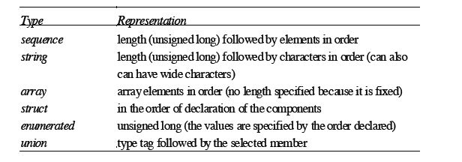
CORBA Common Data Representation (CDR) for constructed types
Can be used by a variety of programming languages.
The data is represented in binary form.
Values are transmitted in sender’s byte ordering which is specified in each message.
May be used for arguments or return values in RMI.

Slide 44
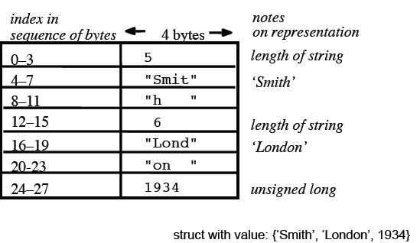
CORBA CDR message
In CORBA, it is assumed that the sender and receiver have common knowledge of the order and types of the data items to be transmitted in a message.

Slide 45
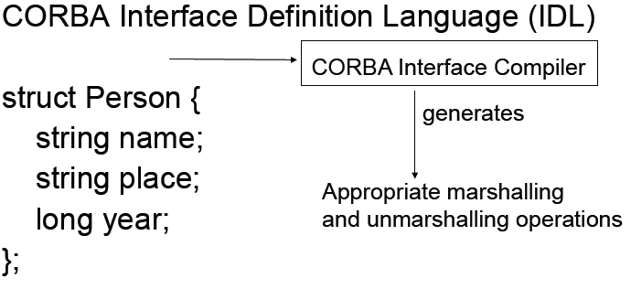

Slide 46
JAVA Object Serialization
public class Person implements Serializable {
private String name;
private String place;
private int year;
public Person(String nm, place, year) {
nm = name; this.place = place; this.year =
year;
}
// more methods
}

Slide 47
Serializable interface: effect of allowing the instances to be serialized.
Serialization: the activity of flattening an object or connected set of objects into a serial form i.e. suitable for storing on disk or transmitting message.
Handles: reference to an object within the serialized form. E.g. next number in a sequence of positive number

Slide 48
JAVA Serialization
To make use of JAVA serialization:
To serialize the class object, create an instance of the class ObjectInputStream & invoke writeObject() method, passing the object as an argument.
To deserialize an object from a stream of data, open an ObjectOutputStream & use readObject () to reconstruct the original object.
E.g. DataInputStream & readUTF ()
DataOutputStream & writeUTF ()

Slide 49
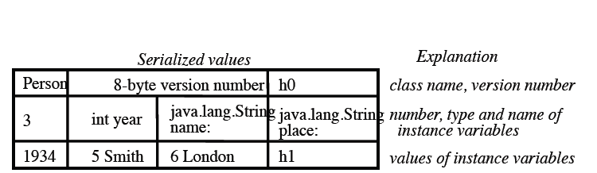
Example
The true serialized form contains additional type markers; h0 and h1 are handles are references to other locations within the serialized form The above is a binary representation of {‘Smith’, ‘London’, 1934}

Slide 50
Web Service use of XML
<p:person p:id=“123456789” xmlns:p=“http://www.andrew.cmu.edu/~mm6”>
<p:name>Smith</p:name>
<p:place>London</p:place>
<p:year>1934</p:year>
</p:person>

Slide 51
The request – reply protocol
Overheads associated with the TCP protocol
Acknowledgements are redundant since requests are followed by replies
Establishing a connection involves two extra pairs of messages in addition to the pair required for a request and a reply
Flow control is redundant for the majority of invocations, which pass only small arguments and results
Request-reply message structure
requestID: prevent duplicated request and delayed reply
Message identifiers
A requestID
An identifier for the sender process, e.g. its port and Internet address

Slide 52
Request-reply communication
Client
Server
doOperation
Request
message
getRequest
select object
(wait)
execute
Reply
method
message
sendReply
(continuation)
public byte[] doOperation (RemoteObjectRef o, int methodId, byte[] arguments)
sends a request message to the remote object and returns the reply.
The arguments specify the remote object, the method to be invoked and the arguments of that method.
public byte[] getRequest ();
acquires a client request via the server port.
public void sendReply (byte[] reply, InetAddress clientHost, int clientPort);
sends the reply message reply to the client at its Internet address and port.

Slide 53
Request-reply message structure
messageType
int (0=Request, 1= Reply)
requestId
int
objectReference
RemoteObjectRef
methodId
int or Method
arguments
array of bytes

Slide 54
Failure model
Timeout
doOperation return exception when repeatedly issued requests are all timeout
Duplicate request messages: filter out duplicates by requestID
if the server has not yet sent the reply, transmit the reply after finishing operation execution
If the server has already sent the reply, execute the operation again to obtain the result. Note idempotent operation, e.g., add an element to a set, and a contrary example, append an item to a sequence

Slide 55
HTTP: an example of a request – reply protocol
Over TCP
Each client-server interaction consists of the following steps
The client requests and the server accepts a connection at the default server port or at a port specified in the URL
The client sends a request message to the server
The server sends a reply message to the client
The connection is closed
Persistent connection
Connections that remain open over a series of request-reply exchanges between client and server
Marshalling
Request and replies are marshalled into messages as ASCII text string
Resources are represented as byte sequences and may be compressed
HTTP Methods
GET, HEAD, POST, PUT, DELETE, OPTIONS, TRACE

Slide 56
HTTP request / reply messages
method
URL or pathname
HTTP version
headers
message body
GET
http://www.dcs.qmw.ac.uk/index.html
HTTP/ 1.1
Request Message
HTTP version
status code
reason
headers
message body
HTTP/1.1
200
OK
resource data
Reply Message

Slide 57
Group Communication
A service is implemented as a number of different processes in different computers, to provide fault tolerance or to enhance the availability.
Multicast Operation: An operation that sends as single message from one process to each of the members of a group of processes

Slide 58
Characteristics of Multicast
Fault tolerance based on replicated servers:
Replicated services on group of servers.
Finding the discovery servers in spontaneous networking:
To locate available discovery services in order to register their interface
Better performance through replicated data:
Multicast the process to manage the replicas
Propagation of event notifications:
Notify the group of processes.

Slide 59
IP Multicast
Built on top of IP.
Allow the sender to transmit a single packet to a set of computers that form a multicast group.
Specified by a Class D Internet Address.
Membership of group is dynamic.
IP Multicast is available only via UDP.
Multicast Routers: Multicast on Internet.
Multicast Address Allocation:
Permanent : Assigned by authority
Temporary: select random IP from Class D for any group.

Slide 60
JAVA API for IP Mulitcast
MulticastSocket : Subclass of DatagramSocket
Methods:
joinGroup();
leaveGroup();

Slide 61
Multicast peer joins a group and sends and receives datagrams
import java.net.*;
import java.io.*;
public class MulticastPeer{
public static void main(String args[]){
// args give message contents & destination multicast group (e.g. "228.5.6.7")
MulticastSocket s =null;
try {
InetAddress group = InetAddress.getByName(args[1]);
s = new MulticastSocket(6789);
s.joinGroup(group);
byte [] m = args[0].getBytes();
DatagramPacket messageOut =
new DatagramPacket(m, m.length, group, 6789);
s.send(messageOut);
// next slide

Slide 62
// get messages from others in group
byte[] buffer = new byte[1000];
for(int i=0; i< 3; i++) {
DatagramPacket messageIn =
new DatagramPacket(buffer, buffer.length);
s.receive(messageIn);
System.out.println("Received:" + new String(messageIn.getData()));
}
s.leaveGroup(group);
}catch (SocketException e){System.out.println("Socket: " + e.getMessage());
}catch (IOException e){System.out.println("IO: " + e.getMessage());}
}finally {if(s != null) s.close();}
}
}

Slide 63
Reliability and Ordering of Multicast
Some examples:
Fault tolerance based on replicated services: all members receive request message in the same order without failure.
Finding discovery servers: multicasts the requests in periodic intervals
Better performance through replicated data
Propagation of event notifications

Slide 64
Case study of IPC in UNIX
Datagram communication
Datagram Socket
Bind
Sendto
recvfrom
Stream communication
stream socket , bind
Accept
Connect
Write and read

Slide 65
Sockets used for Datagrams
Sending a message
Receiving a message
s = socket(AF_INET, SOCK_DGRAM, 0)
s = socket(AF_INET, SOCK_DGRAM, 0)
bind(s, ClientAddress)
bind(s, ServerAddress)
sendto(s, "message", ServerAddress)
amount = recvfrom(s, buffer, from)
ServerAddress and ClientAddress are socket addresses

Slide 66
Sockets used for Streams
Requesting a connection
Listening and accepting a connection
s = socket(AF_INET, SOCK_STREAM,0)
s = socket(AF_INET, SOCK_STREAM,0)
bind(s, ServerAddress);
listen(s,5);
connect(s, ServerAddress)
sNew = accept(s, ClientAddress);
write(s, "message", length)
n = read(sNew, buffer, amount)
ServerAddress and ClientAddress are socket addresses

